Slide 1
Solution to Market Failure
Name:
Affiliation:
Date:

Slide 2
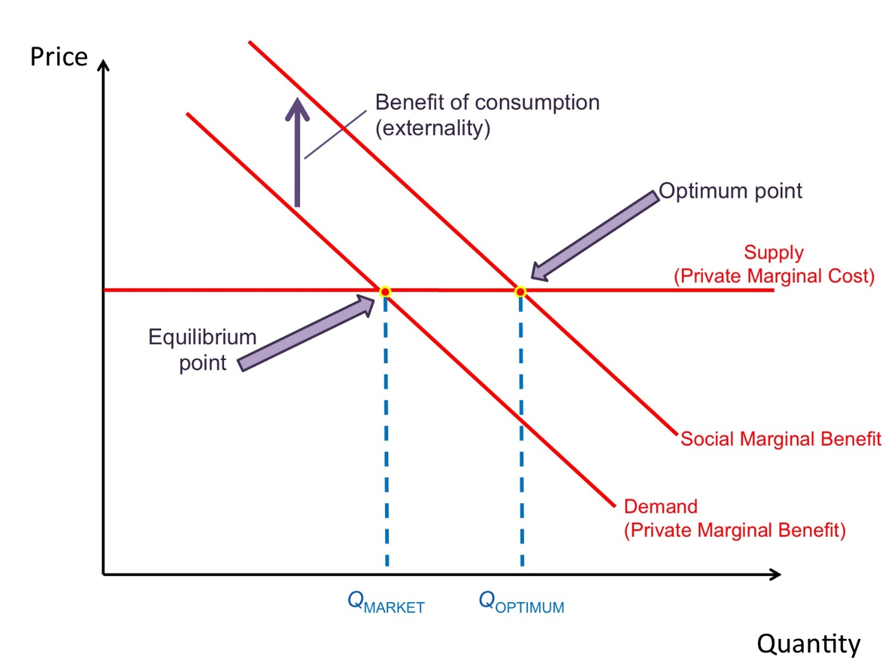
Graphical representation

